Slide 1


DIDI 2021 Stock Market Analysis
Risk Management Team:
Presenters:
Jiani (Catherine) July 2021

Slide 2
Content Catalogue:
Company overview
Quantative analysis for the stock price of DIDI
Qualitative analysis for the risks that DIDI are currently facing
Didi’s prospect
Advice for investors

Slide 3

Company Overview:
Founded in 2012
The dominant ride-hailing startup in China
Operates in nearly 4,000 cities across 15 countries
Has 493 million annual active users and 41 million average daily transactions for the 12 months ended March 31, 2021
In 2020, DiDi booked revenue of $21.6 billion
In 2021 Quarter 1, its revenue is $6.4 billion
Went public on June 30, 2021 under the ticker “DIDI” and raised $4.4 billion

Slide 4
Company Valuation at IPO:
Current Valuationon July 10, 2021:
Quantative analysis

Slide 5
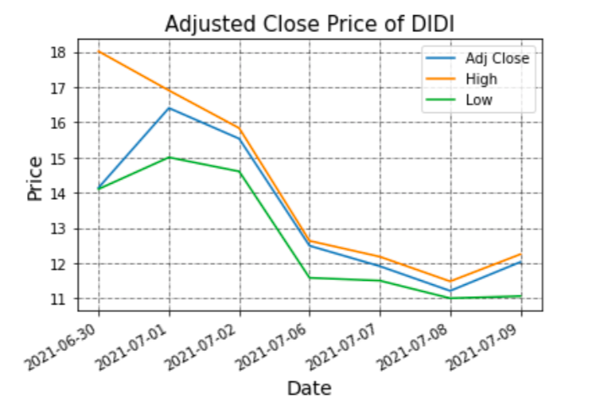
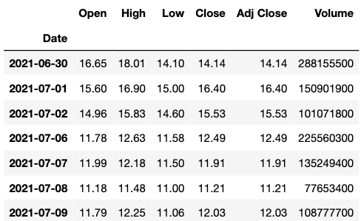

Historical Stock Price:
Quantative analysis
Statistics from June 30, 2021 to July 9, 2021:

Slide 6
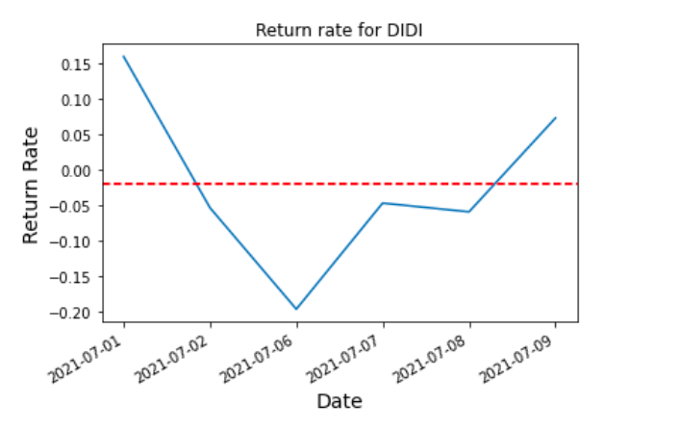
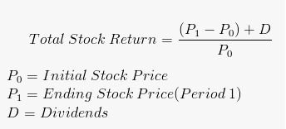
Return Rate
Quantative analysis
20% decrease
Here, Dividends = 0

Slide 7
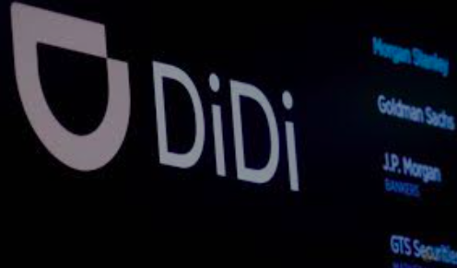
Indexes:
FTSE (July 8, 2021)
DIDI Global Inc was added to the FTSE All-World Index, the FTSE Global Large Cap Index, and the FTSE Emerging Index
S&P (July 12, 2021)
Didi Global Inc was added to S&P Dow Jones' global equity indexes on July 12 2021.
Source: Reuters

Slide 8
Qualititiy analysis: The risks that DiDi are facing
Financial crisis that DiDi faces due to the global pandemic
Revenue in 2020 | Decreased precent from previous year | Annual Loss in 2020
$21.6 Billion | 8.4% | $1.6 Billion
The Situation is getting better b/c China has almost recovered from the COVID-19:
Revenue in 2021 Q1 | Net Income
$6.4 Billion | $837 Million

Slide 9

Cyberspce Security Investigation
Didi has been accused of violating Chinese lasws and regulations in its collection and use of personal data.
Chinese Administration of Cyberspace security review office announced a probe into Didi on national security grounds.
DIDI was removed from the Chinese App Sore platform.
Photo: Pixabay

Slide 10
Possible outcomes:
The best scenario: The review finds no national security risks and Didi’s app will be made available for download again.
The worst scenario: Didi could be ordered to suspend its operation for a rectification, and then as a result, loses its market dominance.
But anyway, Didi’s investors are likely to bear to burnt of any financial losses caused by the prob.

Slide 11
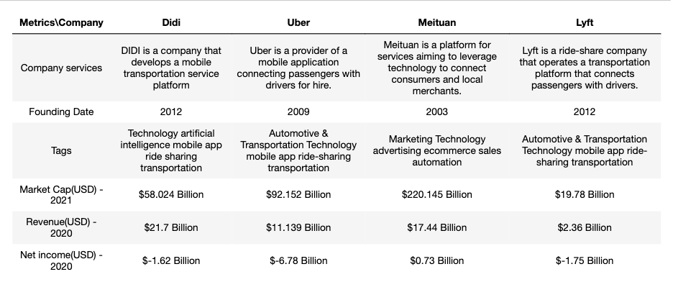
Didi’s top competitors:

Slide 12
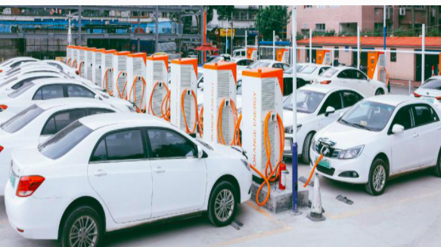
What’s next for DIDI?
Invest in technology, specifically AI
(Tech capabilities, including shared mobility, electric vehicles and autonomous driving technologies)
Global expansion began in 2018
Source: Forbes

Slide 13

Advice for investors
Be patient and wait for a few quarters to see whether if lives up to the hype.
The Cyberspace investigation has just begun.
It’s a newly listed stock.

Slide 14
Thank you !
Risk Management Team:
Risk Analyst: Jiani (Catherine) Song

